Slide 1
Dressing to Win in the Workplace Dress to impress. Dress for success
AGM L&D

Slide 2

Introduction
This training will guide you on AGM’s standards for:
Dress Code
Personal Grooming
Ablution Hygiene
Our goal is to ensure you feel confident and professional in your workspace.
And remember, this is about setting everyone up for success, not creating pressure.

Slide 3
By the End of this Session, You Will Know…
AGM’s proper business attire
What to wear
What not to wear
Basic personal grooming
Post-ablution tips

Slide 4
Dress Code
قواعد الزي

Slide 5
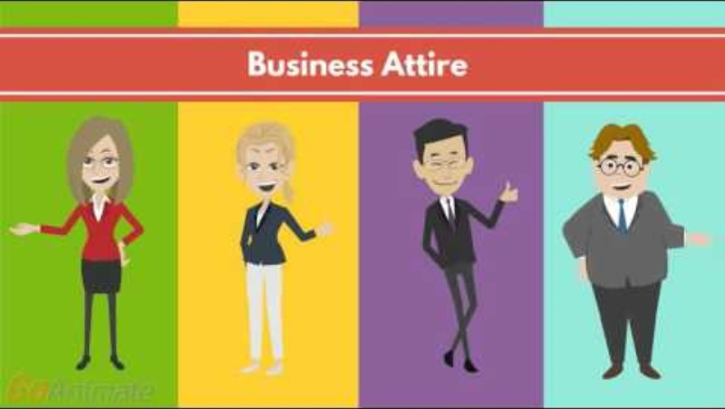
Notes:
FIRST 44 SECS ONLY

Slide 6

Proper Business Attire
In the professional world, guidelines exist to ensure you represent your company well in interactions with others.
Your appearance is no exception. Dressing appropriately not only presents a professional image for AGM but also benefits your career.
In this presentation we’ll talk about the proper business attire at AGM.
Notes:
Benefits career through:
First Impressions,
Confidence Boost,
Cultural Fit,
Career Advancement,
Building Trust,
Influence on Interactions:

Slide 7
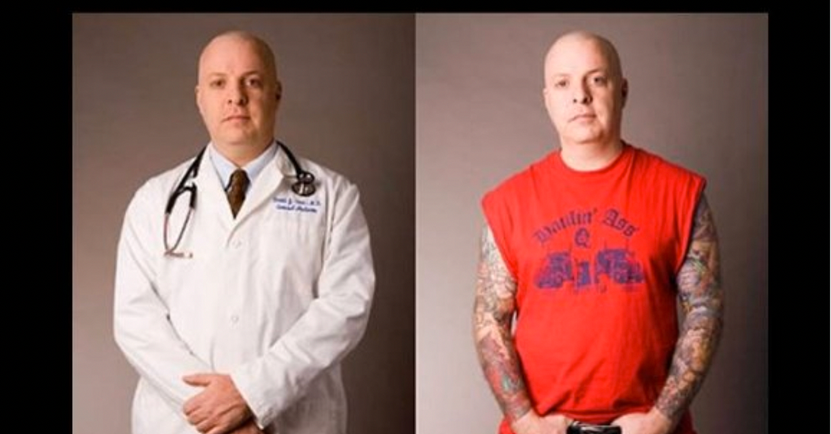
The Power of Attire

Slide 9
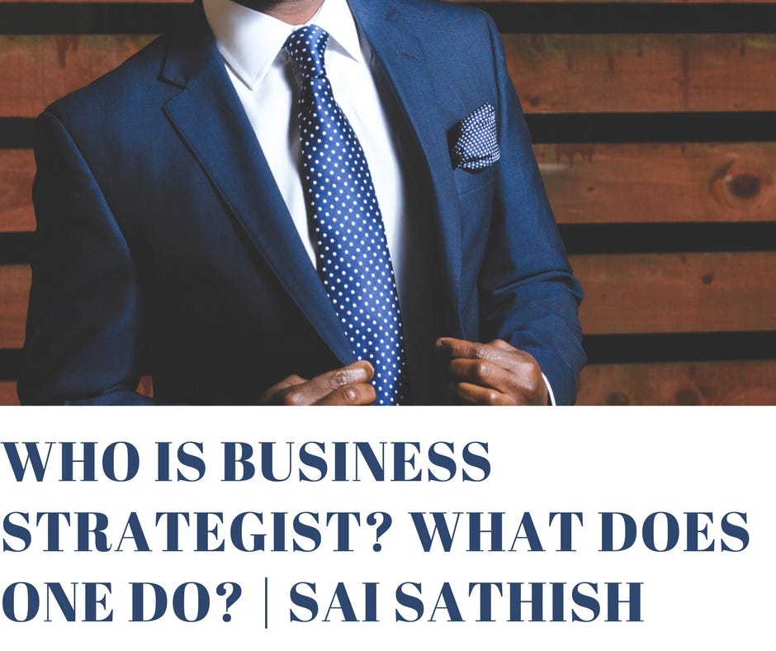
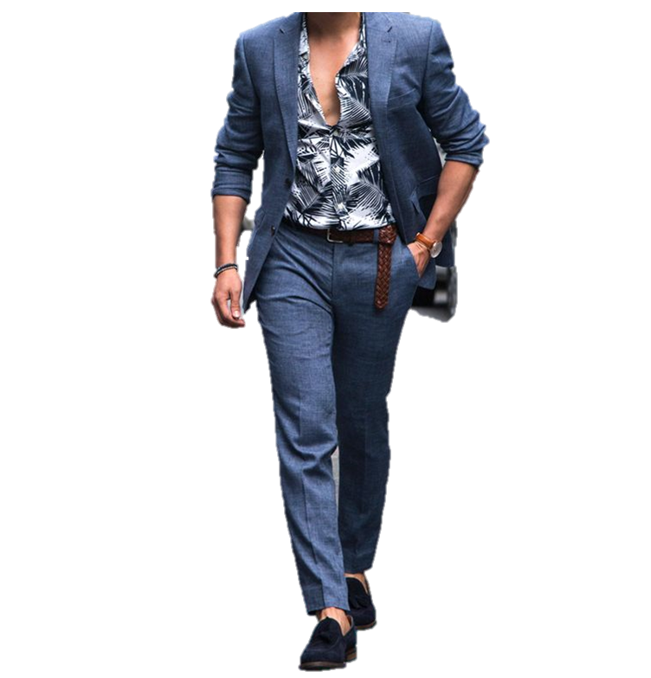

The Power of Attire
Despite efforts not to make judgments based on appearance, yet it plays a crucial role in business success.
Imagine walking into a room for the first time, your attire instantly speaks to who you are, both personally and professionally. First impressions matter and can be lasting.
Being well-groomed and dressed shows you take your work seriously and earns you the respect of others.
Notes:
Some of the perceptions people can form solely from your appearance are:
Your professionalism
Your credibility
Whether these perceptions are real of imagined, they emphasize how your appearance instantly influences the opinions of strangers, peers and superiors.

Slide 10
Dress Code Policies
A dress code is a set of guidelines provided to employees that outlines appropriate attire.
Companies differ in their expectations and requirements for employees’ attire.
Notes:
IF YOU DRESS DOWN IN A FORMAL ATTIRE ORGANIZATION (during an interview)

Slide 11
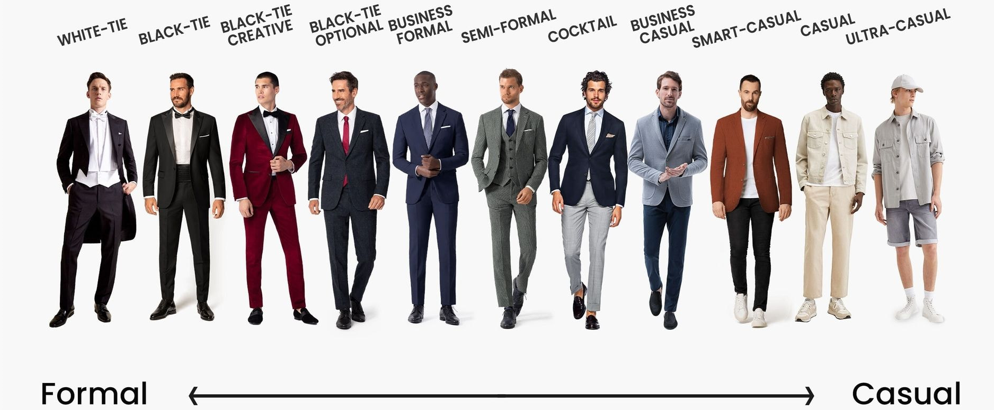
Dress Code Scale
Notes:
WHAT DO YOU WEAR FOR INTERVIEWS? WHY?

Slide 12
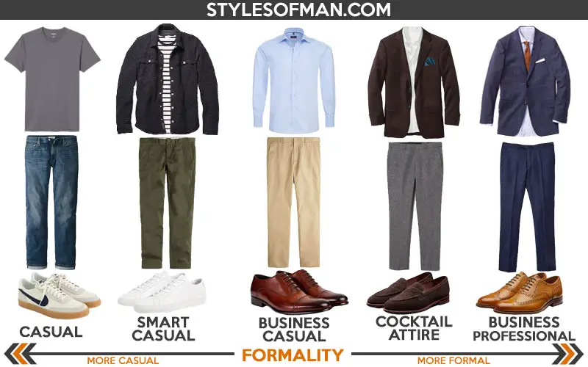
Dress Code Policies… Made Simple

Slide 13
Dress for Success: Balancing Comfort with Professionalism at AGM
While some companies may have a very strict dress code, here at AGM the objective is to have our employees more relaxed, yet reflecting AGM’s image to our colleagues, visitors and customers.
Before you wear something to work, ask yourself:
Is it appropriate for the kind of job I have? Does it reflect AGM’s image?
Does it fit properly? Do I feel confident wearing it?

Slide 14
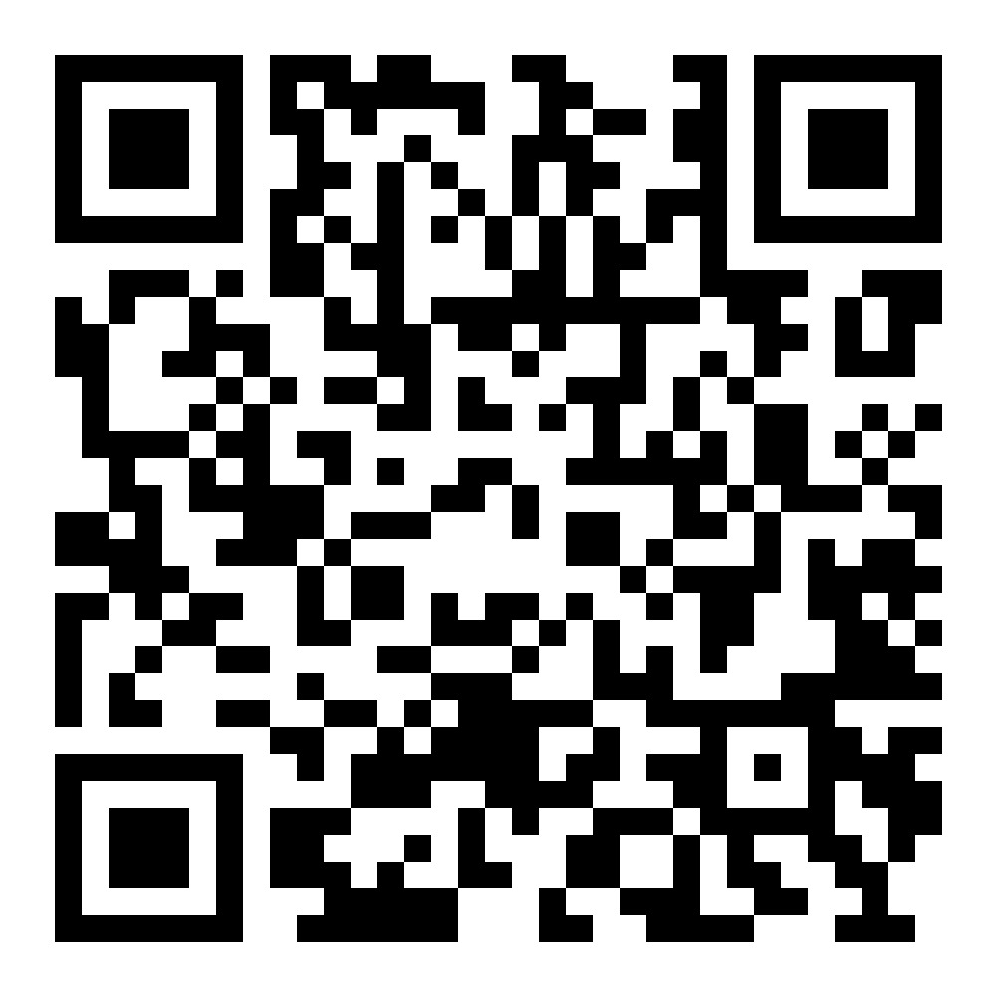
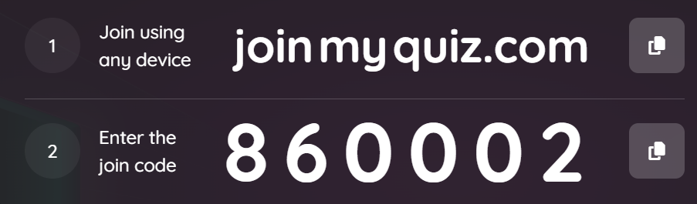
AGM Dress Code:
Business Casual (for non-customer facing employees only)
Notes:
SCAN THE QR CODE FOR THE POLL. PS: LINK IS NOW INVALID. IT NEEDS TO BE REFRESHED BEFORE EACH SESSION.

Slide 15
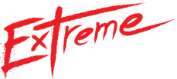
AGM Dress Code:
Business Casual (for non-customer facing employees only)
Business casual is a mix of formal and casual clothing. It’s less formal than business wear, like suits, but still professional.
It is meant to provide an opportunity to work in a more relaxed type of clothing.
Business casual is probably one of the least understood descriptions of appropriate business attire in the workplace.
Casual to the :
Sometimes when employees hear business casual, they dress down and trade-in slacks/pants for jeans, shirts for T-shirts, and leather shoes for sneakers.
Notes:
INCLUDED IN APPRAISAL: how you present yourself

Slide 16
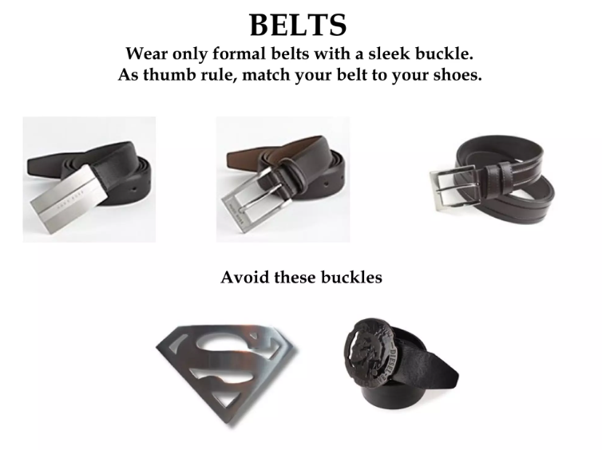
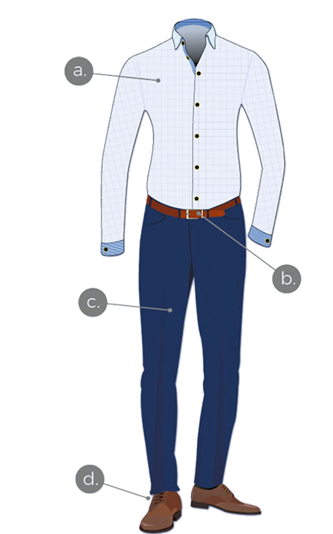
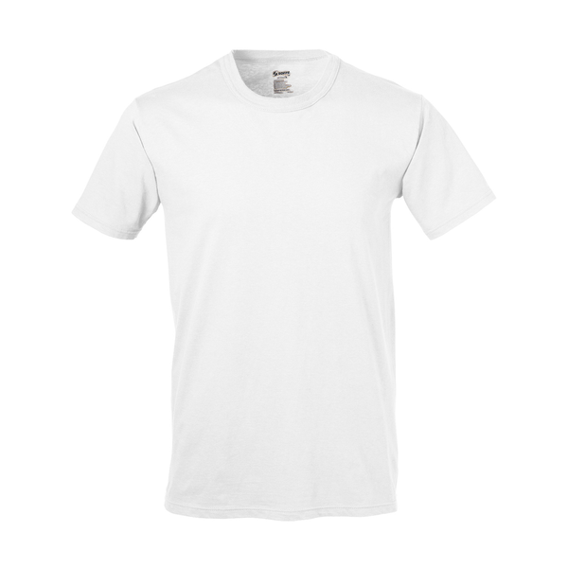
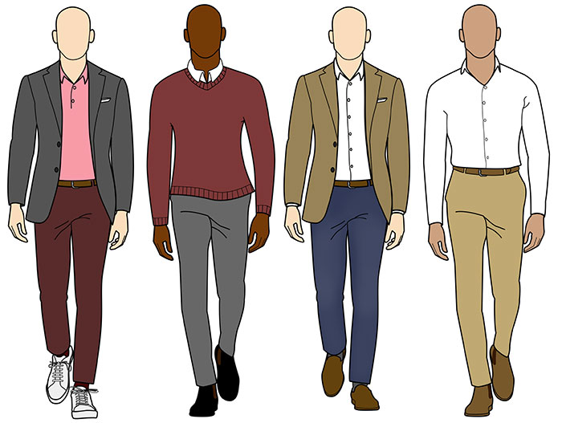
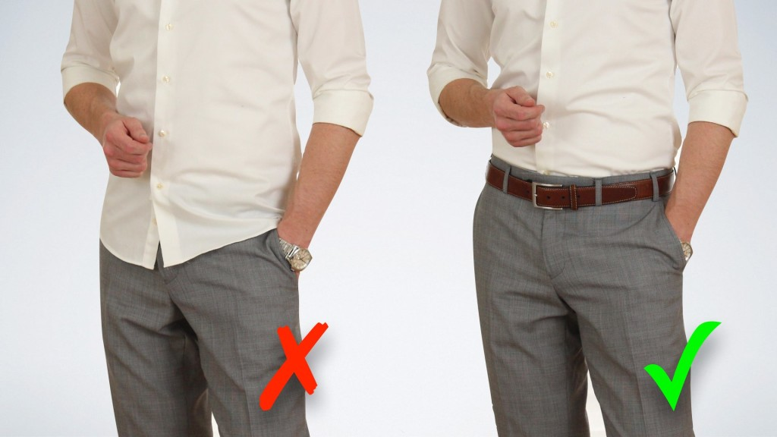
Business Casual Men
a. Shirts
Collared and buttoned
Pressed and wrinkle-free
Tucked in
No graphic prints
White undershirts
b. Belts
Should match shoes
Avoid large buckles
c. Pants
No jeans or sweatpants
Slacks and khakis
Pants should cover the shoe tips
d. Socks and Shoes
Dress socks matching with pants
Mid-calf socks matching the outfit
No sports socks
Polished leather or suede shoes
No sneakers or athletic shoes
Notes:
ASHYAK VERSION

Slide 17
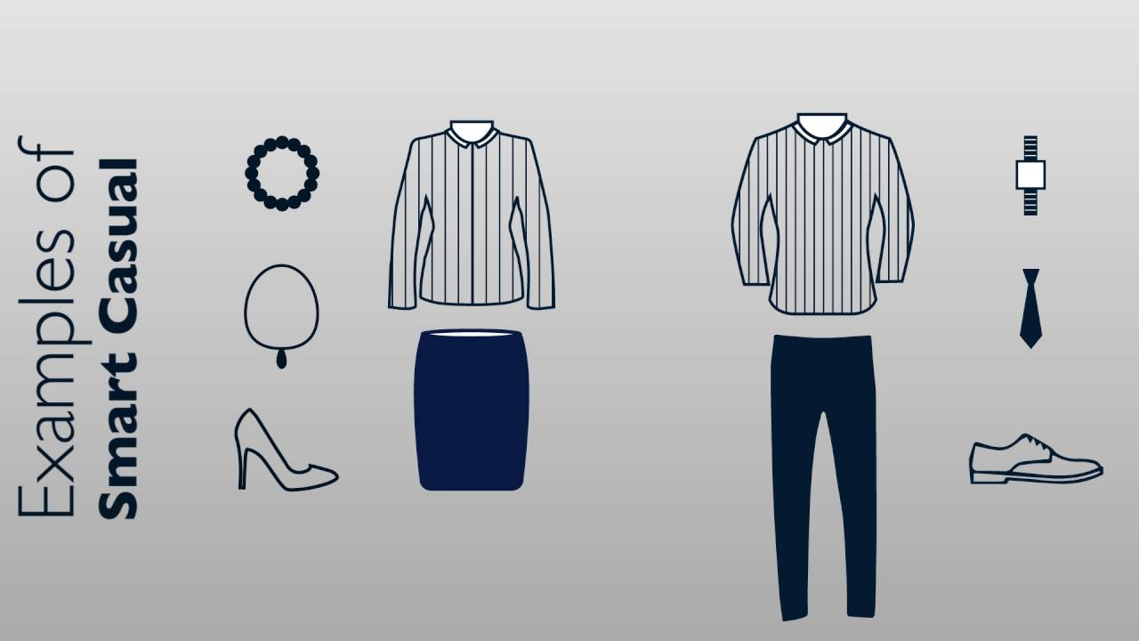
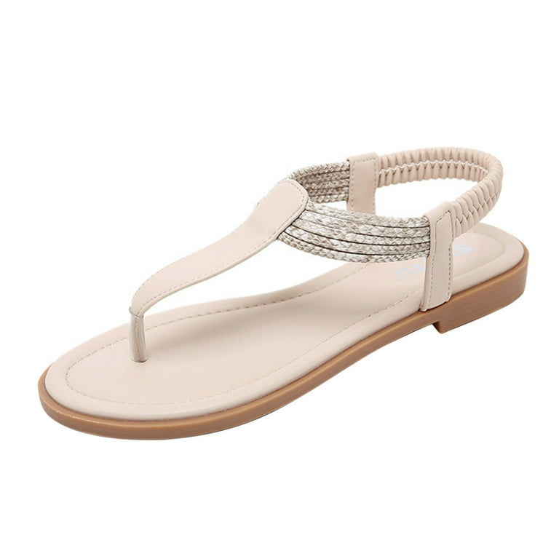
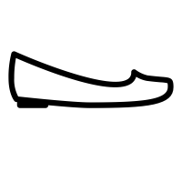
Business Casual Women
a. Blouses
Pressed and wrinkle-free
No graphic prints or T-shirts
b. Pants
No jeans or sweatpants
c. Skirts
Under-knee skirts
d. Dresses
Under-knee dresses
e. Shoes
Flats or low-heeled
No sneakers or athletic shoes
No flip-flops
e. Accessories
Minimal, simple accessories

Slide 18
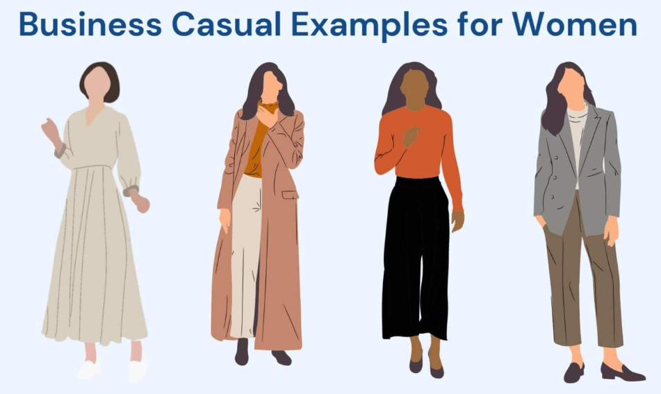
Business Casual Women

Slide 19
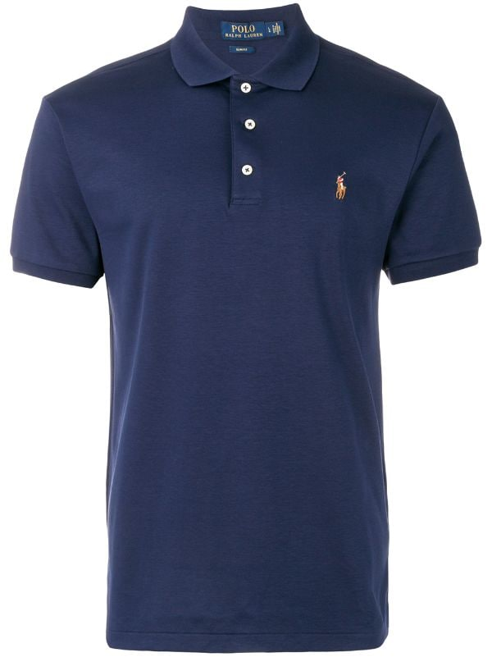
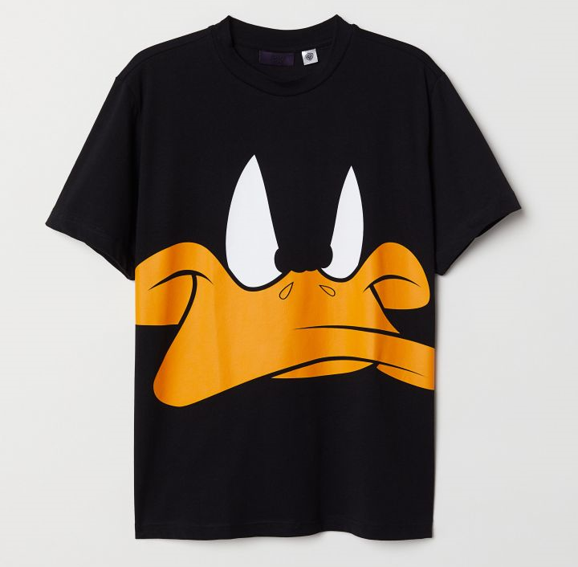
Casual Thursdays

Slide 20
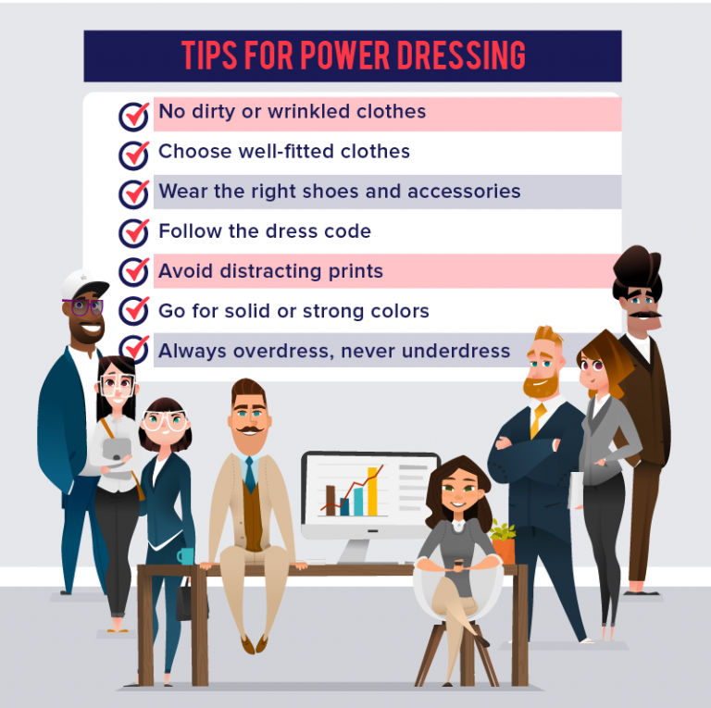
Putting It All Together
Dress for the position you want, not the one you have
Always be ready to meet your boss’s boss
Finishing touches make the difference; pay attention to the details
Never underestimate the power of first impressions

Slide 21
Personal Grooming
العناية الشخصية

Slide 22
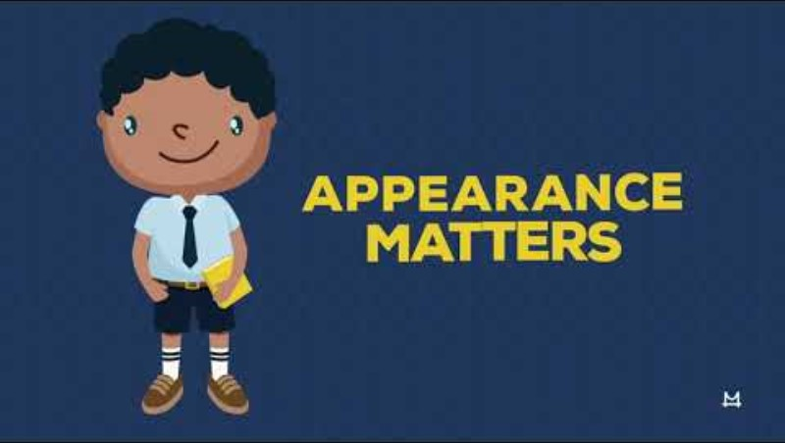

Slide 23
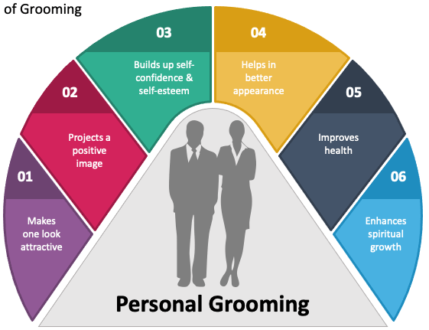
Personal Grooming
Grooming refers to the practices and habits that help individuals maintain a clean and presentable appearance.

Slide 24
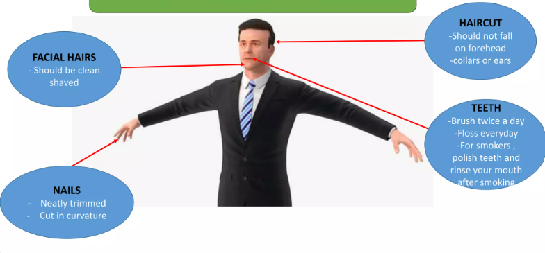
Personal Grooming Men
Hair Care
Regularly washed
Well maintained and styled
Facial Hair
Regular shaving
Well-groomed beard and moustache
Oral Hygiene
Regular brushing and flossing
Mouthwash or rinse after smoking
Nails
Clean and dirt-free
Neatly trimmed
Personal Hygiene
Body odor
Using deodorants and light perfumes

Slide 25

Personal Grooming Women
Hair
Make-up
Nails

Slide 26
Ablution Hygiene
الوضوء

Slide 27
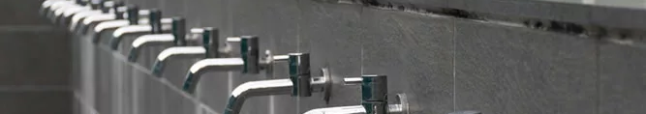
Ablution Understanding the Issue
Spilling water on floors during ablution and stepping onto carpets with wet feet can lead to:
Hygiene Concerns
Bacteria and fungi: skin diseases
Unprofessional Environment
Unpleasant odors and wet areas
Increased Maintenance Costs
Cleaning/replacing carpets

Slide 28
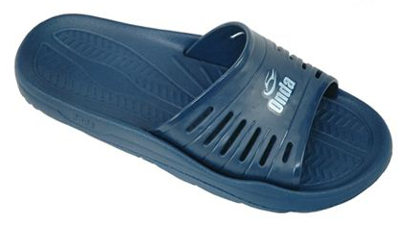
Ablution Hygiene
Dry hands, arms, face and head thoroughly:
Using tissues, ensure different body parts are dried completely before stepping onto carpets to maintain hygiene.
Wipe Down Surfaces:
After ablution, use tissues to wipe any surfaces that may have gotten wet, such as sinks or countertops and ensure that used paper are disposed appropriately in bins to maintain cleanliness.
Encourage Personal Responsibility:
Remind colleagues to leave the space as they found it.
Notes:
NO SHEBSHEB

Slide 29
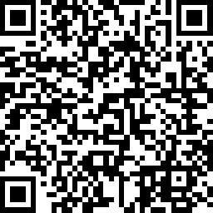
Your Input Matters Suggestions Survey

